Slide 1
MA317 Group Coursework

Slide 2
Introduction
Maintaining world banks of each operations for international database.
World development indicators for labor, agriculture, and food.
Applying various examining sections for WDI modifications.
Indicator code 11 and its five different components.
Determining each components as per the requirements made.
Notes:
The worldwide databases was created to serve as a global development statistics library, and it has been expanded to help develop and administer the financial institutions in each area.
The global bank was responsible for the growth of indication script 11 and it was launched as a modest explanation in the form of an index.

Slide 3
Descriptive Statistics
Using the code and indicator name describing variables accordingly.
Developing a data set structure retrieved through statistics.
Summary of the dataset includes Country code and name, class, and mode.
Differentiating Gross Domestic product and mortality rate.
Measuring life expectancy and infant mortality using GDP per capita.
Notes:
Various 26 characteristics were started on the groups of program, and the identities were changed as per the comfort of the values in the list provided.
The graph represents the death rates and GDP per capita were started; this allows us to view the risk of dying as income per capita decreases.

Slide 4
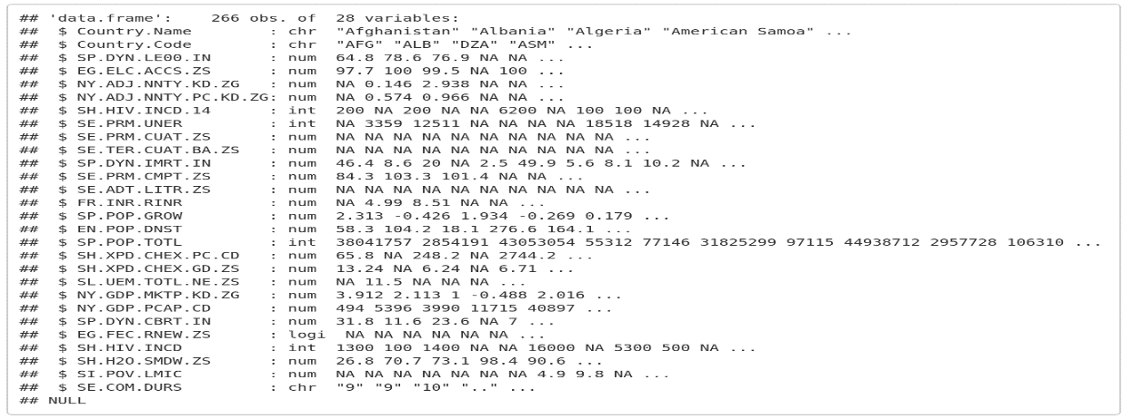
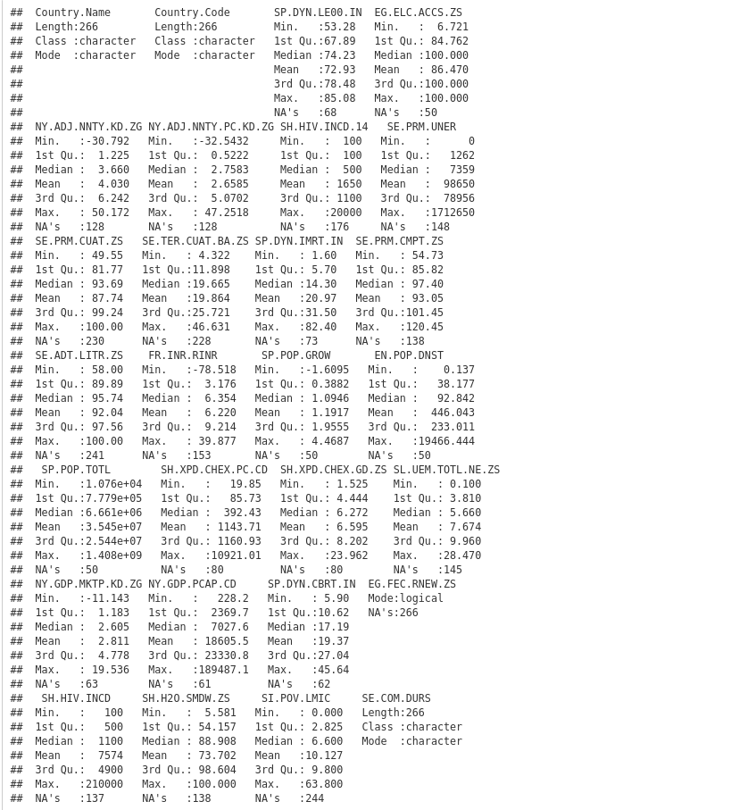
Descriptive Statistics
Notes:
The above analysis looked at average lifespan and GDP per capita, that serves to combine increases in a nation’s GDP with increases in person’s average lifespan.
Data on fatality rate and GDP per capita were produced in the preceding analysis, which aid in integrating child mortality for increases in GDP per capita.

Slide 5
Dealing with Missing values
Inspecting the collection for incomplete data.
Analysing the number of not applicable options in each indicator.
Determining each indicators with missing values.
Indicators describing the total number of non-applicable values.
In terms of developing, the ntree simulates the formation of groupings.
Notes:
Its variables, such as unemployment and sustainable sources, are fully not applicable, and 14 of the 28 metrics with more than 50 percent not applicable are detected.
It provides several analogous choices for reversing the OOB in distinct variables individually rather than pooling the entire data matrices in it.

Slide 6
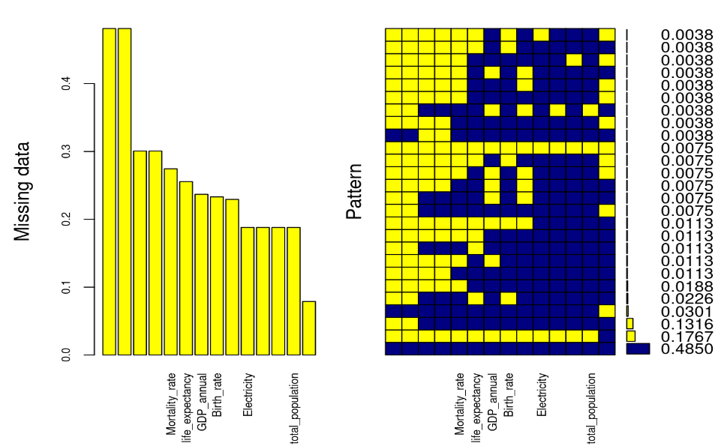
Dealing with Missing values
Notes:
The Miss forest was created using the randomized forest method. This is a non-parametric methodology chosen that can be used with a variety of variables.
If y any forms of an arbitrary function, the non-parametric technique, which is connected to the system and also they will not be used to make explicit assertions.

Slide 7
Collinearity analysis
Examining the datasets from 80 percent to 20 percent based on training and testing sets.
Variance Inflation Factor for determining the value of indicators.
Because of the incompatibility and as an outcome of unpredictability.
Plotting the diagnostics of regression and residuals of life expectancy.
Notes:
80 percent of the dataset will be used for learning, while the remaining 20 percent will be used for assessment. Conducting regression analysis using average lifespan as the dependent variable y and the rest as the factor after restoration.
The RMSE was 1.78, and the R-square was 0.918 checking the co-integration at the same time.

Slide 8
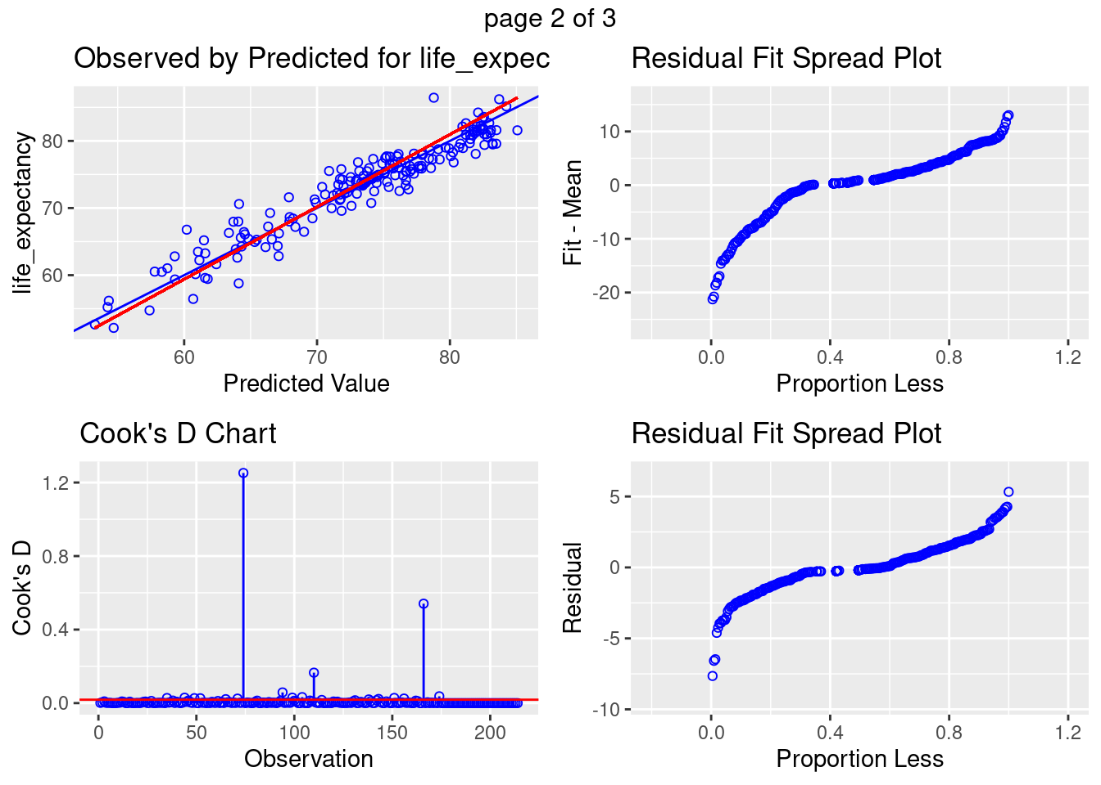
Collinearity analysis
Notes:
If a lot of the problems are due to a lack of interoperability instead of exploratory faults, the model should be abandoned and a fresh one produced.
The lack of fitting F test would only be consistent using simple linear regression.

Slide 9
Living standards estimate
Start collecting data for authentication purpose.
Chassis for testing with a 10 fold data augmentation.
Creating structures for the better processing situation.
Choose the finest design that takes place in MAE, RMSE, and Rsquared.
Notes:
Whether or if the design which has been created will be useful. Participants will use analysis process to judge the effectiveness of a forecast that is based on unlabeled data.
A ten-fold data preprocessing procedure will be used to measure efficiency.

Slide 10
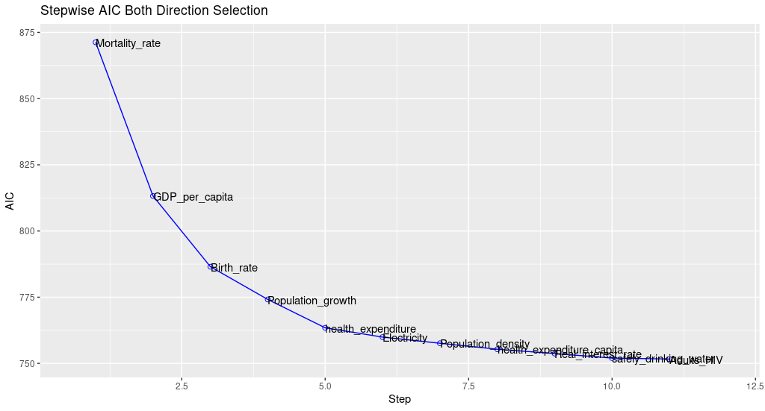
Stepwise AIC both direction
Notes:
The proposed methods is by far the most accurate. The proposed method is by far the most accurate one as throughout the verification, the data will be checked and seeing how reliable it is.
As a result, unbiased final examination of the top design’s accuracy will be offered.

Slide 11
Experimentation designing
Analysis of life_expectancy_data was applied.
219 observations was gained.
NA values removed for error computation.
ANOVA was helped to determine the countries difference.
Notes:
Hence, in order to make the effective analysis the life_expectancy_date1.csv was applied. Whereas it processes with the 219 observations through variables with 5. Some of the variables which contains the NA values were effectively removed in order it will emerge with the error through computation. Hence, the one way of ANOVA was highly helpful for the determination and to find the difference between the countries given.

Slide 12
Experimentation designing
 | DF | Sum sq | Mean sq | F value | P- value
Continent | 5 | 6414 | 1283 | 53.49 | <2e-16
Residuals | 191 | 4581 | 24
Notes:
Finally with the end of experiment it was gained that the p-values were <2e-16, it was observed with the lesser values through 0.05 significance level. Hence, we mitigated the null hypothesis in order it was analyzed the variance through method of life expectancy considering with various countries.

Slide 13
Reference
Akanmu, D. M. & Hassan, M. g., 2020. A preliminary analysis modeling of the relationship between quality management practices and sustainable performance. Quality Management Journal , 27(1), pp. 37-61.
Ali, J., Khan, R., Ahmad, N. & Maqsood, I., 2012. Random Forests and Decision Trees. IJCSI International Journal of Computer Science, 9(5), pp. 1-30.
Biau, G., 2012. Analysis of a Random Forests Model. Journal of Machine Learning Research, Volume 13, pp. 1-33.
Daoud, J., 2017. Multicollinearity and Regression Analysis. Journal of Physics Conference Series, 949(1), pp. 1-30.
Kakkeri, R. B., 2017. Distributed Cable Harness Tester. International Research Journal of Engineering and Technology, 4(5), pp. 1-10.
Pritwani, K., Wasley, K. & Woo, J., 2018. Spark Big Data Analysis of World Development Indicators. Global Journal of Computer Science and Technology: C Software & Data Engineering, 18(3), pp. 1-11.

